Slide 1
Caja Fuerte
Billy Avellán 53828
Sergio Delgado 54288

Slide 2
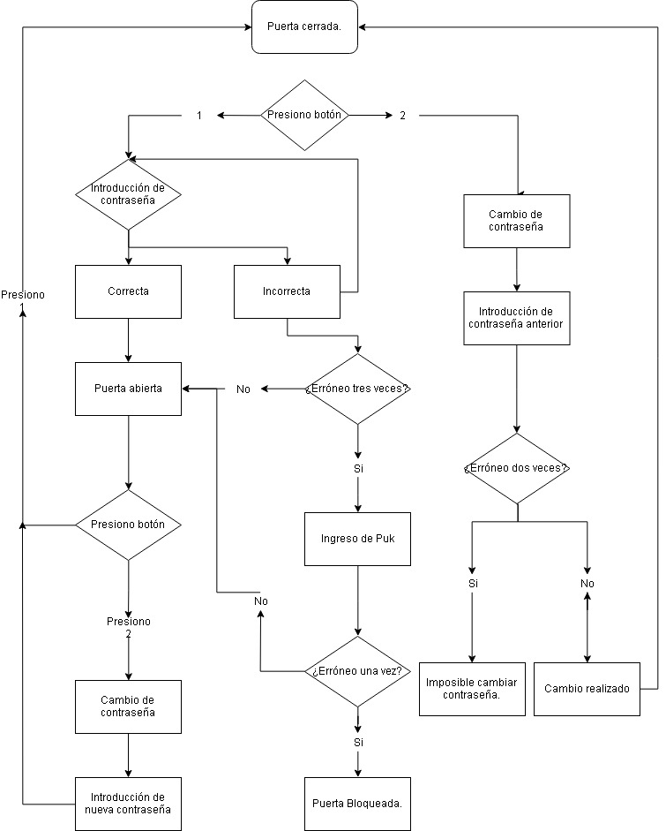
Flujograma

Slide 3
Funciones
void contrasena(FILE *, FILE*, FILE*, int [], struct in []);
void cambio (FILE*, FILE *, struct in []);
void cambio2(FILE*);
void correcto(FILE*, FILE *, int [], struct in [], int );
void incorrecto(FILE *, FILE* ,struct in [], int, int[], int[]);

Slide 4
Ficheros
FILE *con, *inc, *puk, *incc;
errno_t err, err2, err3, err4;
err = fopen_s(&con, "contrasena.txt", "r+");
err2 = fopen_s(&inc, "incorrecto.txt", "w+");
err3 = fopen_s(&puk, "puk.txt", "a+");
err4 = fopen_s(&incc, "incorrectoc.txt","w+");

